Slide 1
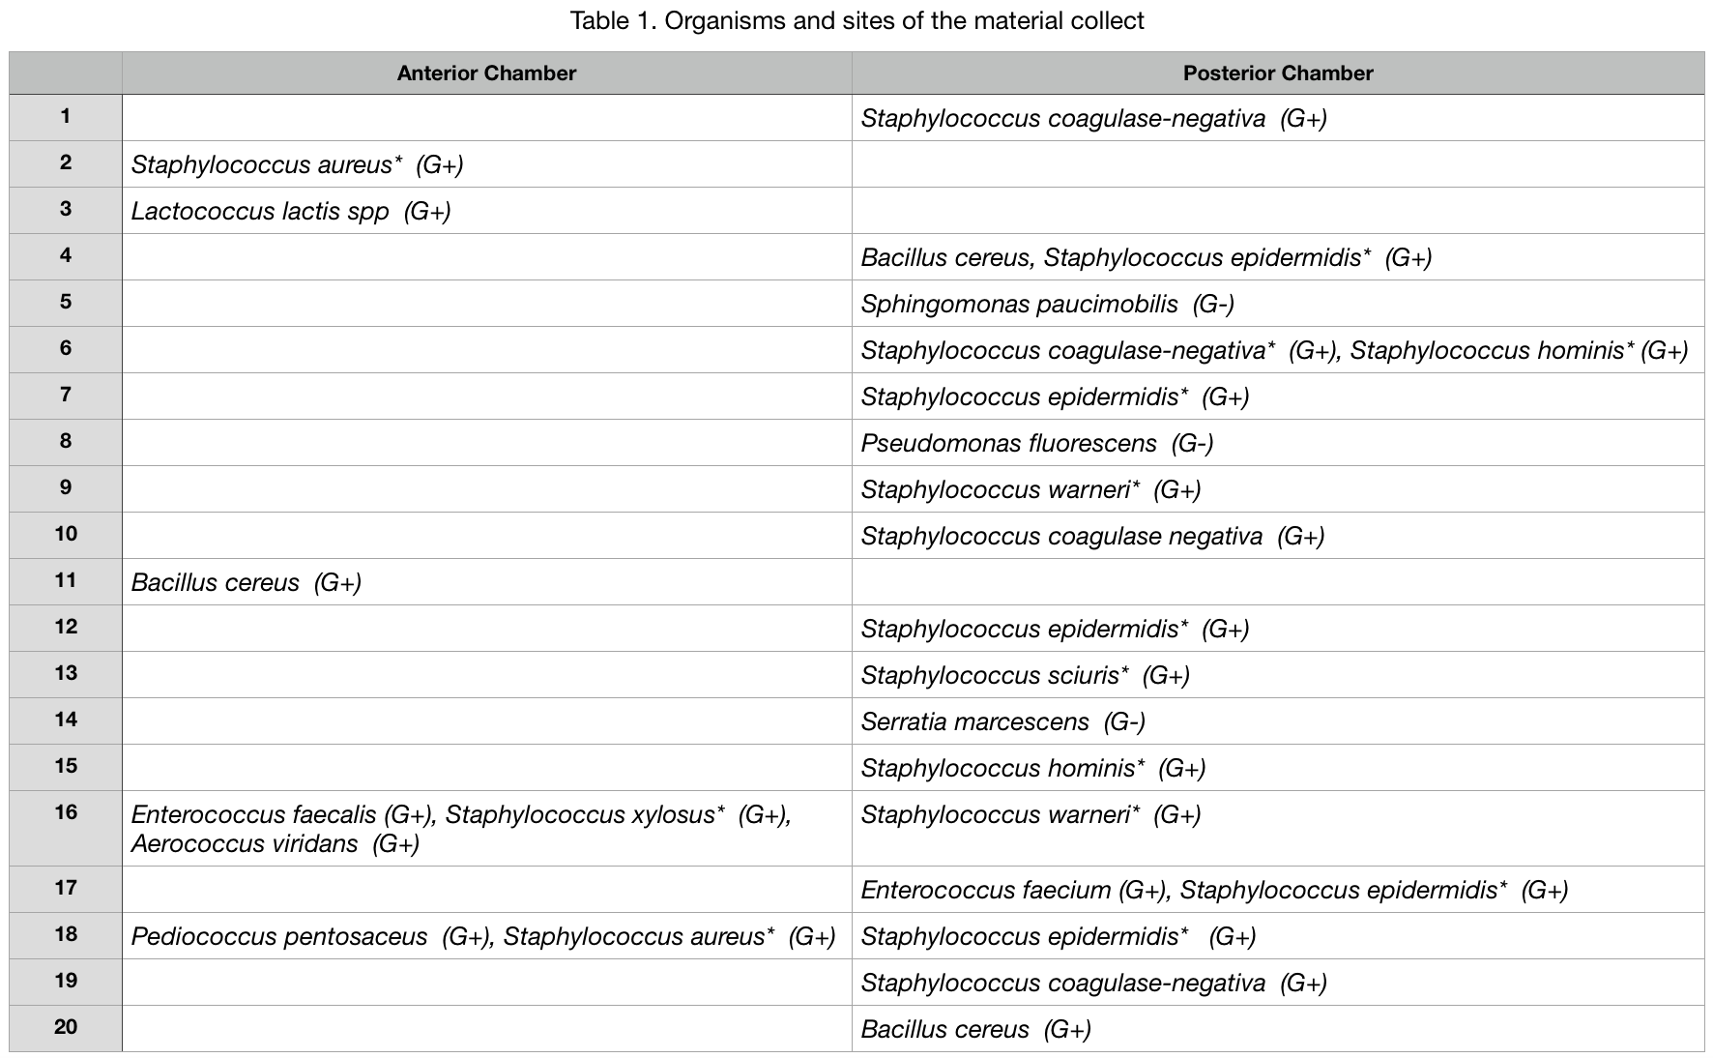
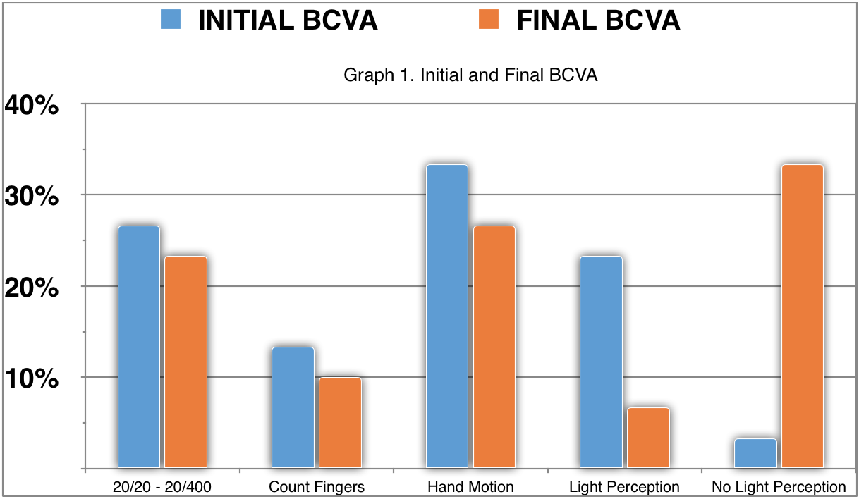
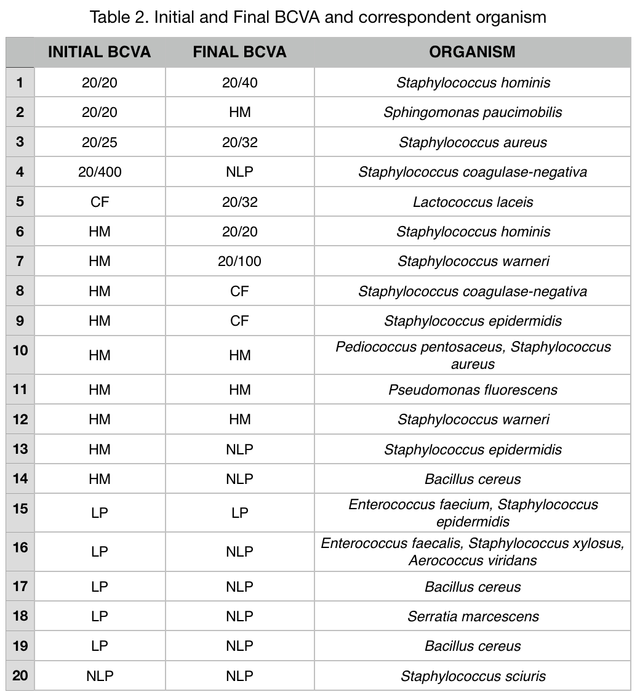
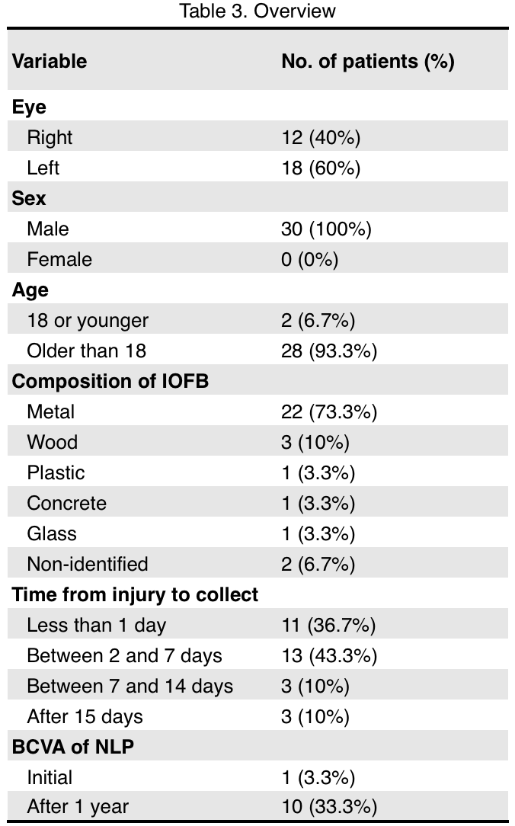
CEP 0060/2018
Epidemiological Analysis of Post Penetrant Trauma Endophthalmitis Evaluated in a Tertiary Brazilian Hospital in 6 Years
Bergamo VC, Nakayama LF, Denadai L, Moraes NSB
BACKGROUND
CONCLUSION
Endophthalmitis is a severe inflammatory ocular disease with profound vision commitment that may lead to irreversible vision loss and needs immediate treatment. It may be classified according to time of symptoms as acute, that occurs until 6 weeks after procedure and late, that occurs more than 6 weeks after procedure. It also may be classified according to etiology as endogenous, when the infectious agent originates from own organism, with hematologic spreading, or exogenous, when etiological agent origin is external from the eye, by direct inoculation. Exogenous etiology are related with ocular trauma, after surgical procedures, corneal infections, contiguous disseminations and intraocular injection. Post operative acute edophthalmitis presents prevalence of 0.03% - 0.2% in United States of America, with 0.04% risk after cataract surgery, after intravitreous injection is reported variable incidence of 0.014 - 0.87% per injection, 0.2% after glaucoma surgery, 0.03% after pars plana vitrectomy. Post traumatic endophthalmitis incidence rate can reach 16.5%.
This is the first Brazilian study that evaluates endophthalmitis cases after ocular trauma with intraocular foreign body, evaluated in a tertiary hospital.
In conclusion, the majority of endophthalmitis cases present guarded prognosis, with worse outcomes when it is secondary to penetrant ocular trauma. The high incidence of acute endophthamitis after trauma justify the distinct evaluation of these patients.
TABLES AND GRAPHS
PURPOSE
Our study aim to evaluate epidemiology of endophthalmitis cases related with penetrant ocular trauma, visual acuity during endophthalmitis and one year after, the presence or absence of intraocular foreign body (IOFB), material of intraocular foreign body, treatment and to establish prognostic factors in these cases.
METHODS
Retrospective study that analyzed epidemiological data of patients who underwent emergency sector evaluation and were submitted to intravitreous or anterior chamber collect with endophthalmitis hypothesis and compatible history of ocular penetrant trauma from January of 2012 to January of 2017 at Hospital São Paulo - UNIFESP. Our institution follows Penetrating Globe Trauma Protocol of immediate hospitalization, with systemic intravenous antibiotics prescription of Cefalotine 1g twice/day and Gentamicine 80mg three times/day, analgesics and nausea relief drugs also are prescript. Allergic patients and renal insufficiency patient receive adequate doses and alternative antibiotics according to allergy. Surgical repair is done as soon as possible, according to patient clinical conditions, to repair corneal and scleral laceration, removing lens when necessary and removing foreign body when possible.
RESULTS
During the period, 420 patients had endophthalmitis suspicion and underwent vitreous or anterior chamber materials analysis. 30 patients (7.12%) had compatible history of penetrant trauma with intraocular foreing body; the mean age was 42.26 years (minimum of 11 years and maximum of 80 years); All the patients were male (100%) and 11 patients (36.66%) had the right eye affected, and 19 patients (63.33%) the left eye. The time from injury to intravitreal material collect varied between 1 day after trauma (36.66%), between 2 and 7 days (43.44%), between 7 and 14 days (10%) and 15 days after trauma (10%). Among the 30 samples, 20 (66.66%) showed positive culture. 12 were positive for Staphylococcus coagulase-negativa (40%) and 3 were positive for Bacillus cereus (10%). The others positive cultures showed variable microorganisms, such as Lactococcus lactis (3.33%), Pseudomonas fluorescens (3.33%), Serratia marcensces (3.33%), Enterococcus faecalis (3.33%), Enterococcus faecium (3.33%), Aerococcus viridans (3.33%) and the rare Sphingomonas paucimobilis (3.33%). 5 samples (16.66%) had more than one organism growth. We also analyzed the composition of intraocular foreign body (IOFB), with metallic injury presented at 22 traumas (73.33%). About the Initial Best Corrected Visual Acuity, 5 patients presented between 20/20 and 20/400 (16.66%), 12 patients at Hand Motion (40%), 7 patients with Light Perception (23.33%) and 1 with No Light Perception (3.33%). One year after the endopthalmitis, 10 eyes presented NLP (33.33%), 2 eyes with LP (6.66%), 6 eyes with HM (20%) and 6 patients better than 20/400. All these findings can be visualized at Table 1, Table 2, Table 3 and Graph 1.
REFERENCES
1. Ahmed Y, Schimel AM, Pathengay A, et al. Endophthalmitis following open-globe injuries. Eye (Lond) 2012;26:212–7.
2. Das T, Hussain A, Naduvilath T, et al. Case control analyses of acute endophthalmitis after cataract surgery in South India associated with technique, patient care, and socioeconomic factors. J Ophthalmol. 2012.
3. Durand ML. Endophthalmitis. Clinical Microbiology and Infection. 2013;19(3):227-34
4. Eifrig CWG, Flynn HW, Jr, Scott IU, et al. Acute-onset postoperative endophthalmitis: review of incidence and visual outcomes (1995–2001) Ophthalmic Surg Lasers. 2002; 33:373–78
5. Essex RW, Yi Q, Charles PG, et al. Post-traumatic endophthalmitis. Ophthalmology. 2004;111:2015–22
6. Fung AE, Rosenfeld PJ, Reichel E. The international intravitreal bevacizumab safety survey: using the internet to assess drug safety worldwide. Br J Ophthalmol 2006;90:1344–49.
7. Jackson TL, Paraskevopoulos T, Georgalas I. Systematic review of 342 cases of endogenous bacterial endophthalmitis. Surv Ophthalmol. 2014 Nov-Dec;59(6):627-35
7. Krause L, Bechrakis NE, Heimann H, et al. Incidence and outcome of endophthalmitis over a 13-year period. Can J Ophthalmol. 2009;44:88–94.
8. Lemley CA, Han DP. Endophthalmitis: a review of current evaluation and management. Retina. 2007 Jul-Aug;27(6):662-80. Review. Erratum in: Retina. 2007
Sep;27(7):table of contents. Dosage error in article text.
9. Ramakrishnan R, Bharathi MJ, Shivkumar C, et al. Microbiological profile of culture-proven cases of exogenous and endogenous endophthalmitis: a 10-year retrospective study. Eye (Lond). 2009 Apr;23(4):945-56.
10. Schwartz SG, Flynn HW Jr, Das T, Mieler WF. Ocular Infection: Endophthalmitis.
Dev Ophthalmol. 2016;55:176-88.
11. Sharma S, Padhi TR, Basu S, Kar S, Roy A, Das T. Endophthalmitis patients seen
in a tertiary eye care centre in Odisha: a clinico-microbiological analysis.
Indian J Med Res. 2014 Jan;139(1):91-8
12. Sheu S-J. Endophthalmitis. Korean Journal of Ophthalmology : KJO. 2017;31(4):283-89.
13. Vahey JB, Flynn HW., Jr Results in the management of Bacillus endophthalmitis. Ophthalmic Surg. 1991;22:681–6.
14. Vaziri K, Schwartz SG, Kishor K, Flynn HW Jr. Endophthalmitis: state of the art. Clin Ophthalmol. 2015 Jan 8;9:95-108.

