Slide 1
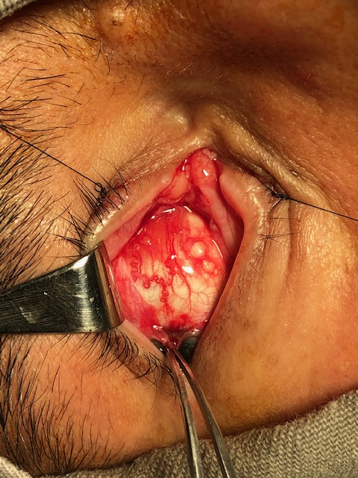
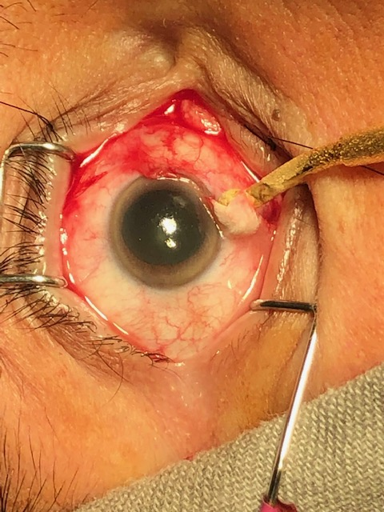
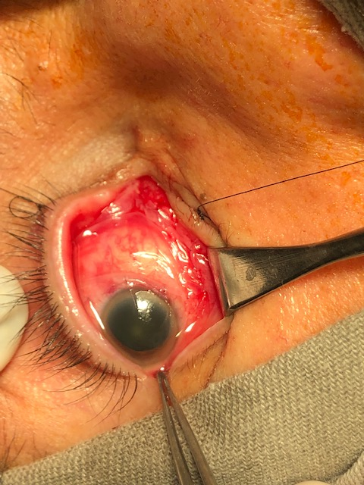
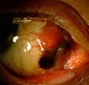
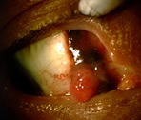
When In Doubt Cut It Out: Zero Tolerance For Conjunctival Melanoma Suspicion
Ferreira TL, Borelli I.M, Morales M.C., Vital JF.
Division of Ophthalmic Plastic Surgery Ophthal – Hospital Especializado LTDA
CASE REPORT
IMAGES 3, 4 AND 5
A 57 year-old caucasian male patient presented with a 2 months history of a painless enlarging pink lesion on the surface of his right eye. There were no visual symptoms nor any previous ocular surgery or trauma. Examination revealed a nonpigmented vascularized conjunctival nodule sorrounded by a pigmented area without any scleral attachment, leading to a diagnostic hypothesis of conjunctival melanoma with na amelanotic component. Differential diagnosis could include a foreign body-induced granuloma, pyogenic granuloma, conjunctival intraepithelial neoplasm. The conjunctival component was surgically removed performing the wide "no touch" technique of conjunctivectomy, achieving tumor-free margins of 5 mm, and followed by double freeze-thaw cryotherapy. Closure was achieved by amniotic membrane transplantation.
After removal of the conjunctival melanoma with 5mm margin
During double freeze thaw cryotherapy
DISCUSSION
A conjunctival melanoma usually presents as a pigmented nodular lesion located at the limbus over or adjacent to an area of PAM in caucasian elderly population. Pigmentation, nodularity, changes in size, prominent feeder vessels and unusual location , should raise the suspicion of a malignant lesion. However, conjunctival melanoma may uncommonly be amelanotic or reddish-pink in color, simulating a malignant epithelial neoplasm, such as conjunctival intraepithelial neoplasia or squamous cell carcinoma, or a more benign inflammatory process, such as nodular episcleritis or pyogenic granuloma. The presence of cysts in an amelanotic lesion favors a diagnosis of amelanotic nevus. A careful evaluation at the slit lamp should be done before surgical excision and may help to determinate the margins of amelanotic lesions.
Aspect after complete transplantation of amniotic membrane in place
CONCLUSION
When prognosis is concerned, the most important aspect of the treatment is a proper first surgical intervention. A “no touch” technique excision should be performed with wide margins (at least 4 mm) from the apparent lesion. Tumor cells should not be irrigated, only normal conjunctiva should be manipulated with instruments; a clean set of instruments should be used after resection of the tumor. It is crucial to complement surgical excision with cryotherapy (double freeze-thaw) at the conjunctival margins. Adjunctive topical chemotherapy, typically with mitomycin C, can be used for recurrent or very extensive lesions.
REFERENCES
1. Shields JA, Shields CL. Conjunctival melanocytic lesions. Atlas of Eyelid and Conjunctival Tumors. Philadelphia, Pa: Lippincott Williams & Wilkins.; 2008;307-48.
2. Seregard S. Conjunctival melanoma. Surv Ophthalmol. 1998;42:321-350.
3. Shields CL, Demirci H, Karatza E, Shields JA. Clinical survey of 1643 melanocytic and nonmelanocytic tumors of the conjunctiva. Ophthalmology. 2004;111:1747-1754.
4. Yu GP, Hu DN, McCormick S, Finger PT. Conjunctival melanoma: Is it increasing in the United States? Am J Ophthalmol. 2003;135:800-806.
5. Shields CL, Fasiudden A, Mashayekhi A, Shields JA. Conjunctival nevi: clinical features and natural course in 410 consecutive patients. Arch Ophthalmol. 2004;122:167-175
IMAGES 1 AND 2
Slit lamp examination: pigmented tumor and its amelanotic component projecting through palpebral fissure

