Slide 1
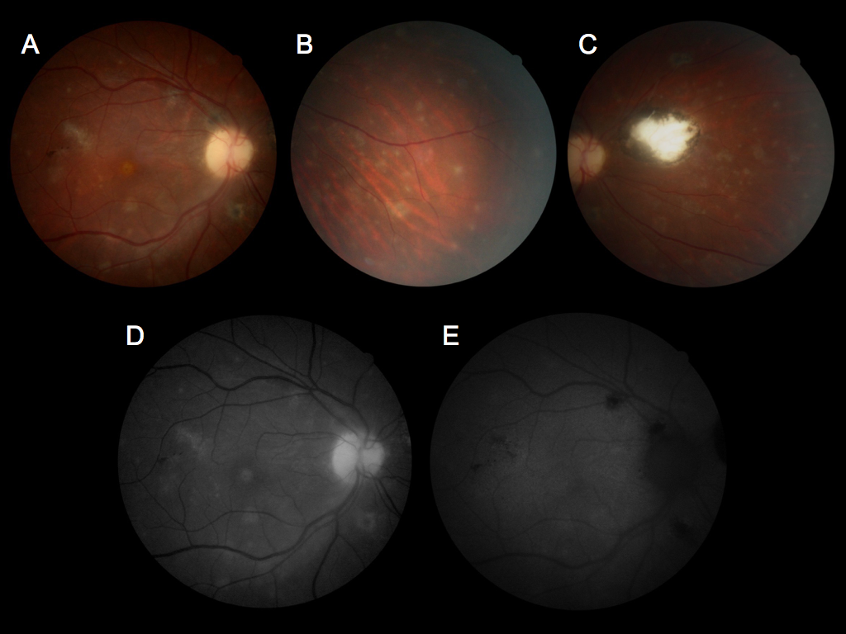
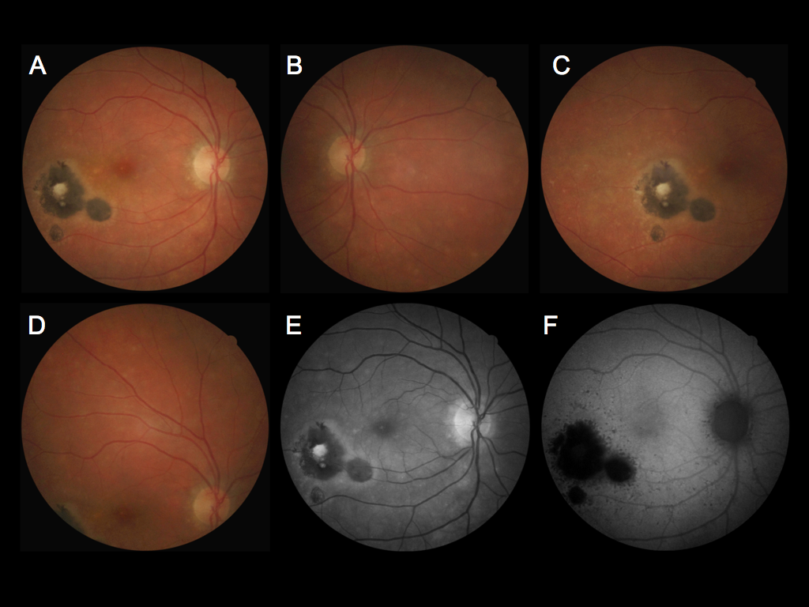
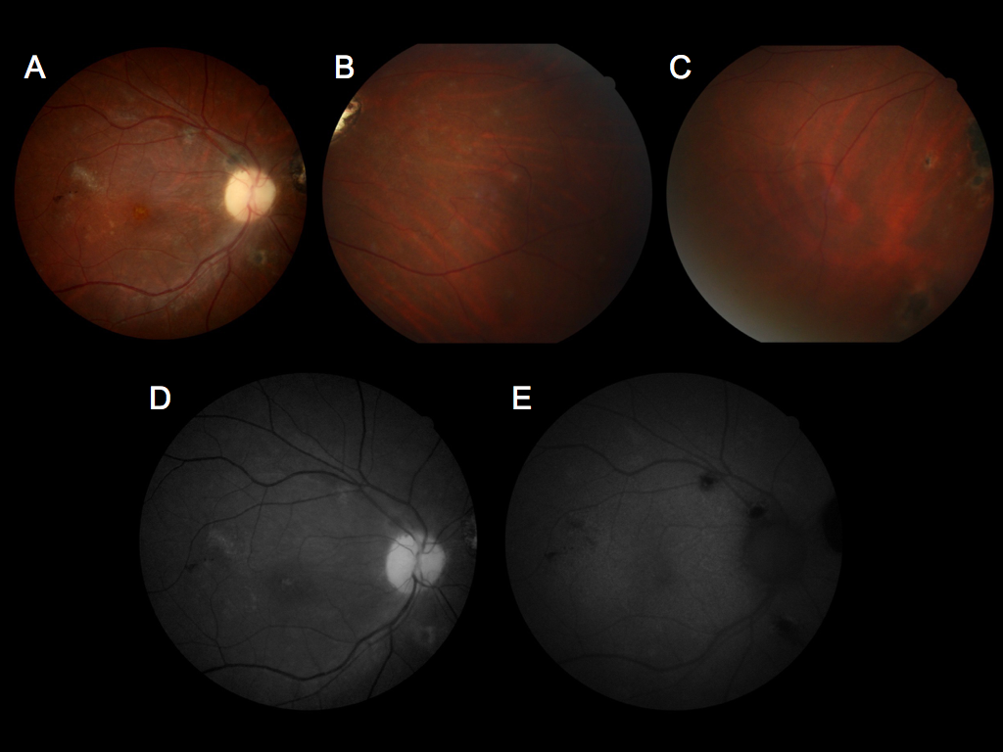
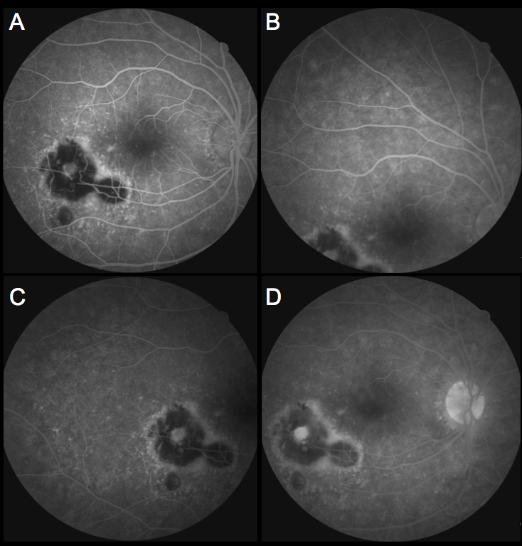
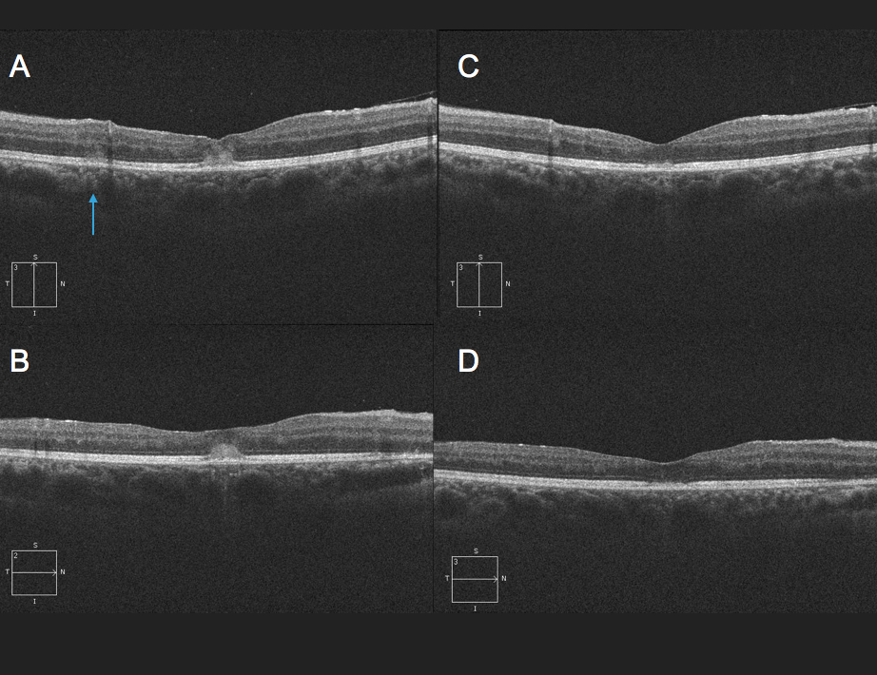
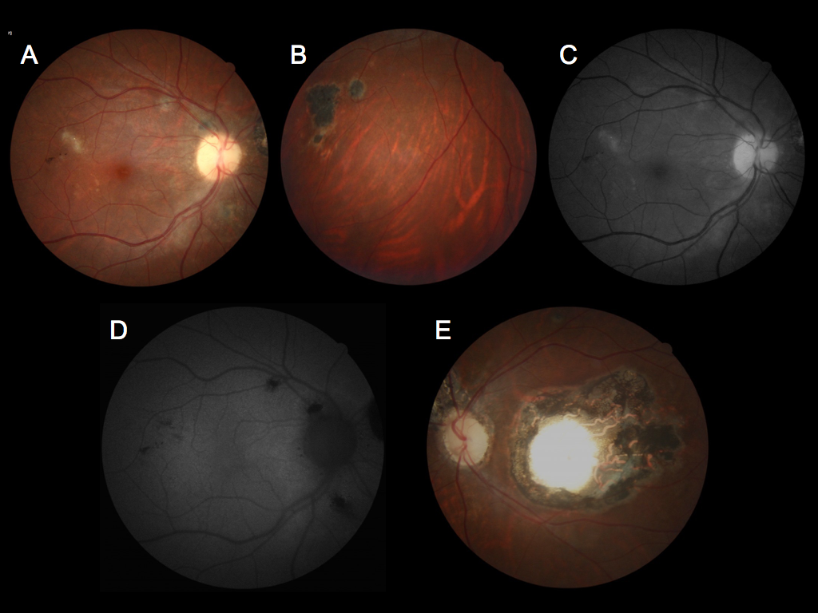
White dot syndrome in patients with prior ocular toxoplasmosis
Fabio B. Aggio¹, Tiago E. F. Arantes¹, Evandro L. Rosa¹, Mário J. Nóbrega¹, K. Bailey Freund^{2,3}
Hospital de Olhos Sadalla Amin Ghanem, Joinville, SC, Brazil¹
Vitreous Retina Macula Consultants of New York, New York, USA²; Department of Ophthalmology, New York University School of Medicine, New York, NY, USA³
Dr K. Bailey Freund is a consultant for Optovue, Zeiss, Heidelberg Engineering, Allergan and Novartis. He receives research support from Genentech/Roche. The remaining authors have no proprietary or financial interests.
This work was supported by The Macula Foundation Inc., New York, NY, USA.
INTRODUCTION
Multiple evanescent white dot syndrome (MEWDS) was first described in 1984 by Jampol et al.¹ It is characterized by unilateral diminished vision and enlargement of the blind spot and has a predilection for young, healthy, myopic females. Retinal findings include macular granularity, multifocal, small white lesions concentrated in the paramacular, peripapillary, and midperipheral fundus, as well as posterior vitreous cells.² Recent studies have shown that MEWDS affects predominantly the outer retina, centered at the ellipsoid zone (EZ) and interdigitation zone (IZ), with some changes extending into the outer nuclear layer (ONL).² The pathogenesis of MEWDS is unknown, although an immune-mediated process in genetically predisposed individuals has been postulated. Toxoplasmosis is the leading cause of infectious posterior uveitis in the world, accounting for 80% of cases in some regions.³ Although toxoplasmosis chorioretinitis usually has a self-limited course, it can lead to irreversible visual loss, particularly when the macula and optic nerve are involved. In 2011, Vance et al. reported a unilateral white dot syndrome occurring in a healthy 27-year-old woman 1 month after documented resolution of recurrent toxoplasmosis chorioretinitis involving the same eye.⁴ Herein, we report 2 similar patients with retinal findings resembling MEWDS in eyes with evidence of prior ocular toxoplasmosis.
CASE REPORT n.1
A 25-year-old healthy woman complained of floaters and photopsia in her right eye (OD) for 2 days. As a child, she was diagnosed with ocular toxoplasmosis in both eyes (OU) and had received treatment for several recurrences of active chorioretinitis OD. Visual acuity in her left eye (OS) had always been poor. On examination, best-corrected visual acuity (BCVA) was 20/30 OD and counting fingers at 3 meters OS. Anterior segment examination was normal OU with no cell or flare detected. Intraocular pressures were 14 mmHg OU. Ophthalmoscopy OD showed inactive peripheral chorioretinal scars and a small deep white lesion with ill-defined margins located superotemporal to the fovea (Figure 1, A-C). Ophthalmoscopy OS revealed inactive chorioretinal scars in the macula and peripheral retina (Figure 1, D and E). No vitreous cells were noted OU.
Figure 2
Figure 5
Figure 3
Figure 6
Previous studies have shown that MEWDS can present after the primary occurrence or recurrence of choroidal neovascularization.⁶ Whether choroidal neovascularization or ocular toxoplasmosis may trigger a white dot syndrome by creating a proinflammatory environment remains to be elucidated. Subclinical reactivation of ocular toxoplasmosis could also be involved. Other studies have reported MEWDS following vaccination⁷ or systemic viral infection⁸, thus an immune-mediated process in genetically predisposed individuals is strongly suggested. Thus, it is possible that toxoplasmosis may trigger a white dot syndrome by means of a local immune-mediated process induced by the parasite.
One interesting aspect of both cases was the predilection for the white dots to occur near the old chorioretinal scars. This pattern was particularly evident on FAF of Case n.2. In the acute phase of MEWDS, FAF demonstrates: (1) multiple, small (< 50 µm) autohypofluorescent areas in the posterior pole and (2) areas of increased autofluorescence corresponding to white dots seen on ophthalmoscopy.⁹ In the case n.2, we noted multiple hypoautofluorescent dots around the chorioretinal scars, the optic disc head and near the inferotemporal vascular arcade. These lesions may represent subretinal inflammatory infiltrate or loss of the retinal pigment epithelium and suggest a connection between the chorioretinal scars and the development of the white dot syndrome.
In conclusion, we report 2 new cases of a white dot syndrome resembling MEWDS in 2 patients with prior ocular toxoplasmosis. Further study is needed to determine if this white dot syndrome is causally related to the presence of prior ocular toxoplasmosis or merely a coincidental occurrence.
References
Jampol LM, Sieving PA, Pugh D, et al. Multiple evanescent white dot syndrome. I. Clinical findings. Arch Ophthalmol 1984;102:671-674.
Marsiglia M, Gallego-Pinazo R, de Souza EC, et al. Expanded clinical spectrum of multiple evanescent white dot syndrome with multimodal imaging. RETINA 2016;36:64-74.
Oréfice F, Vasconcelos-Santos DV, Cordeiro CA, et al. Toxoplasmosis. In: Foster CS, Vitale AT: Diagnosis and treatment of uveitis. Jaypee - Highlights, Inc. New Delhi, India 2013; 543-568.
Vance SK, Freund KB, Wenick AS, et al. Diagnostic and therapeutic challenges. Retina 2011;31:1224-1230.
Yannuzzi NA, Gal-Or O, Motulsky E, et al. Multimodal imaging of punctate outer retinal toxoplasmosis. Ophthalmic Surg Lasers Imaging Retina 2018, In Press.
Mathis T, Delaunay B, Cahuzac A, et al. Choroidal neovascularisation triggered multiple evanescent white dot syndrome (MEWDS) in predisposed eyes. Br J Ophthalmol 2018;102:971-976.
Abou-Samra A, Tarabishy AB. Multiple evanescent white dot syndrome following intradermal influenza vaccination. Ocul Immunol Inflamm 2018;25:1-3.
Yang CS, Hsieh MH, Su HI, Kuo YS. Multiple evanescent white dot syndrome following acute Epstein-Barr virus infection. Ocul Immunol Inflamm 2017;11:1-7.
Uy Harvey S, Chan PS. Multiple evanescent white dot syndrome. In: Foster CS, Vitale AT: Diagnosis and treatment of uveitis. Jaypee - Highlights, Inc. New Delhi, India 2013; 1050-1055.
Figure 4
Fluorescein angiography OD showed multiple early hyperfluorescent dots which became confluent around the chorioretinal scars and temporal paramacula. Some of the dots formed a “wreath-like” pattern, and there was late staining of the optic nerve (Figure 6). The patient was started on a 6-week course of BID oral sulfamethoxazole/trimethoprim (800mg/160mg). Laboratory studies included normal leukocyte and erythrocyte counts, a normal erythrocyte sedimentation rate and negative serologic testing for HIV and syphilis (VDRL and FTA-ABS). A chest x-ray was normal. Toxoplasma immunoglobulin M antibodies were negative, but immunoglobulin G antibodies were positive (101UI/mL). Two weeks later, BCVA was 20/20-1 OD and 20/20 OS. Anterior segment examination OD showed 0.5+ anterior chamber reaction. Mild vitreous opacities were still present. There was partial resolution of the gray-white retinal lesions. One month later, BCVA was 20/20 OU. There was no anterior chamber or vitreous cells OU. The gray-white dots OD had disappeared, but there was still mild foveal granularity.
CONCLUSIONS
The cases herein reported presented with clinical findings resembling MEWDS including macular granularity, vitreous cells and multiple evanescent deep gray-white retinal lesions. Multimodal retinal imaging including FAF, OCT and fluorescein angiography showed changes similar to those seen with typical MEWDS.² Both patients had chorioretinal scars characteristic of prior toxoplasmosis chorioretinitis. The ocular history of the first patient, with poor vision in 1 eye since childhood and prior treatment for recurrent chorioretinitis, was suggestive of congenital toxoplasmosis.
The history and imaging findings of our cases closely resemble a case reported by Vance et al. in which there was an initial concern regarding early reactivation of ocular toxoplasmosis.⁴ Similar to this prior case, both of our patients were treated with oral anti-toxoplasma therapy. Our first patient was also treated with oral corticosteroids. A diagnosis of punctate outer toxoplasmosis (PORT) was considered, since multifocal gray-white lesions at the level of the deep retina and retinal pigment epithelium have been described with this entity. However, the 2 cases herein reported presented with findings that were more widespread than the lesions described with PORT. Minimal retinal pigment epithelium involvement and the absence of persistent retinal pigment epithelium changes or new scars following resolution were also inconsistent with PORT. Furthermore, while the initial descriptions of PORT occurred prior to the availability of high-resolution OCT, a recent study has shown that both inner and outer retinal involvement occur, as well as punctate preretinal hyperreflective lesions⁵, which were not present in our cases. We admit that treatment could have altered the course of our patients’ disease.
Figure 1
Given concern regarding a possible recurrence of toxoplasmosis chorioretinitis OD, the patient was started on a 6-week course of BID oral sulfamethoxazole/trimethoprim (800mg/160mg). Five days later, she returned complaining of worsening of vision OD. BCVA was 20/50 OD. Anterior segment examination was unchanged. Ophthalmoscopy OD revealed 1+ vitreous cells, macular granularity and multiple scattered deep gray-white lesions OD. The lesions were more numerous around the old chorioretinal scars (Figure 2, A-D). Ophthalmoscopy OS remained unchanged. Fundus autofluorescence (FAF) showed faint hyperautofluorescence corresponding to the multiple gray-white lesions (Figure 2, E). Spectral domain optical coherence tomography (OCT) of the deep retinal lesions (Figure 4, A, arrow) showed disruption of the EZ and IZ with no abnormalities detected anterior to the ONL. There were no changes involving the retinal pigment epithelium/Bruch’s membrane complex, except at the fovea where there was a thin hyporeflective splitting of this hyperreflective band and a dome-shaped accumulation of subretinal hyperreflective material (Figure 4, A and B). The patient completed the 6-week course of sulfamethoxazole/trimethoprim and also received a brief course of oral prednisone. Laboratory studies included normal leukocyte and erythrocyte counts, a normal erythrocyte sedimentation rate, and negative serologic testing for HIV and syphilis (VDRL and FTA-ABS). A chest x-ray was normal. Toxoplasma immunoglobulin G antibodies were positive in an enzyme-linked immunosorbent assay (ELISA) (132 IU/mL). Anti-toxoplasma IgM antibodies were negative. One month later, BCVA had improved to 20/40 OD. Macular granularity was still present OD, but the gray-white retinal lesions had partially faded (Figure 3). There were no persistent vitreous cells. Structural OCT OD showed resolution of the foveal dome-shaped hyperreflective material, with persistent EZ/IZ attenuation (Figure 4, C and D). One month later, BCVA was 20/30. Macular granularity persisted, but the gray-white retinal lesions were undetectable.
CASE REPORT n.2
A 37-year-old healthy woman complained of reduced visual acuity OD for 2 weeks. Past ocular and family history were unremarkable. On examination, BCVA was 20/40 OD and 20/20 OS. Findings on slit-lamp and ophthalmoscopic examination OS were normal. Anterior segment examination OD disclosed 1+ anterior chamber reaction. Intraocular pressures were 14 mmHg OU. Ophthalmoscopy OD showed 1+ vitreous cells, mild macular granularity, 3 inactive pigmented chorioretinal scars inferotemporal to the fovea, as well as multiple scattered deep gray-white lesions, more numerous at the posterior pole (Figure 5). FAF OD showed faint hyperautofluorescence surrounding multiple scattered hypoautofluorescent dots that were more numerous around the chorioretinal scars and optic nerve.

