Slide 1


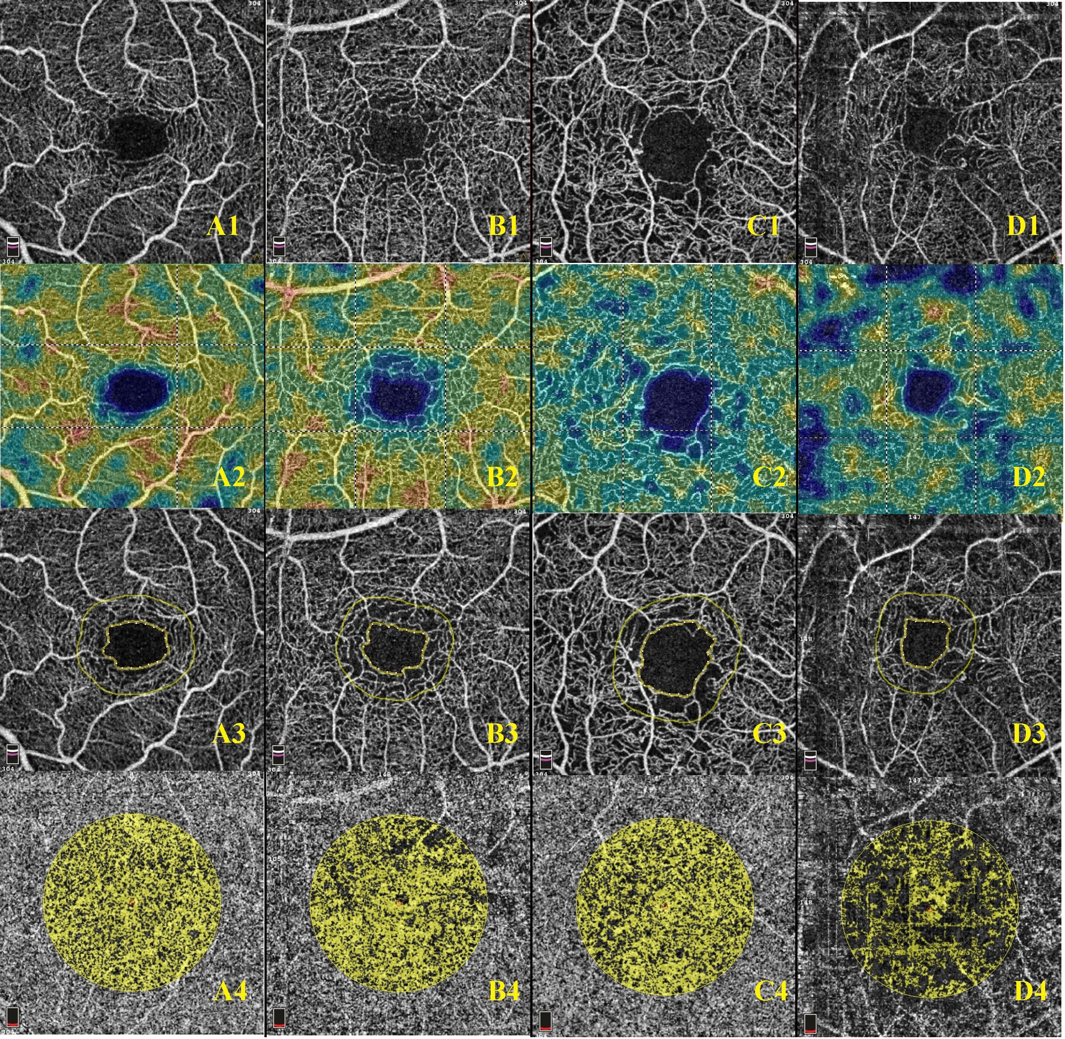
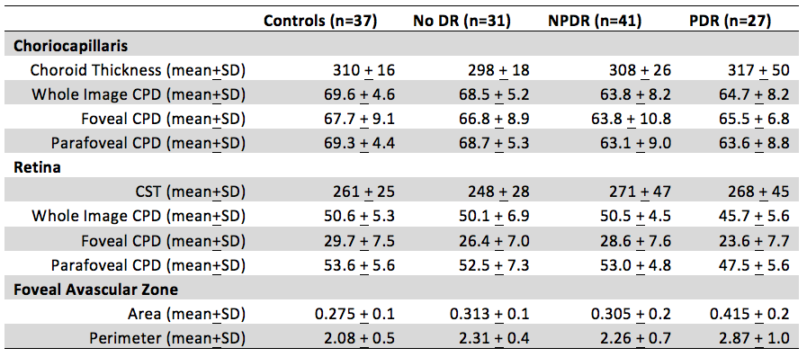
Choriocapillaris And Retinal Vascular Plexus Density Of Diabetic Eyes Using Split-spectrum Amplitude Decorrelation Spectral Domain Optical Coherence Tomography Angiography
Felipe F. Conti MD^{1,2}, Eduardo B. Rodrigues MD³, Sumit Sharma MD¹, Aleksandra Rachitskaya MD¹ Justis Ehlers, MD¹, Rishi P. Singh MD¹
¹Cole Eye Institute, Cleveland Clinic, Cleveland; ²Federal University of São Paulo, São Paulo;
INTRODUCTION
Recent advances in optical coherence tomography angiography (OCTA) imaging allows detailed evaluation of capillary perfusion density (CPD), an indicator of vascular integrity. A retrospective, observational clinical study was performed to assess retinal and choriocapillaris CPD changes in diabetic eyes and controls using OCTA.
METHODS
Records of 131 eyes who underwent spectral domain-OCT (SD-OCT) imaging at a single institution were reviewed. Subject eyes were classified based on pathology: proliferative diabetic retinopathy (PDR, 26 eyes), non-proliferative diabetic retinopathy (NPDR, 41 eyes), no diabetic retinopathy in a diabetic patient (DR, 31 eyes), and non-diabetic controls (37 eyes). For each eye, SD-OCT obtained 3x3mm images of the macular region and split-spectrum amplitude decorrelation angiography (SSADA) algorithm generated angiographic images. Quantitative CPD analysis was performed with AngioVue automated software.
RESULTS
Compared to controls (69.6±4.6), choriocapillaris whole image CPD was significantly decreased by 7.1% in eyes with PDR (64.7±8.2), decreased by 8.3% in eyes with NPDR (63.8±8.2) and decreased by 1.6% in eyes without DR (68.5±5.2, p<0.001 for all comparisons). Compared to controls (69.3±4.4), choriocapillaris parafoveal CPD was also significantly decreased, by 8.2% in eyes with PDR (63.6±8.8), decreased by 8.9% in eyes
with NPDR (63.1±9), and decreased by 0.9% in eyes without DR (68.7±5.3, p<0.001 for all comparisons). Compared to controls (50.6±5.3), retinal whole image CPD was significantly decreased by 9.7% in eyes with PDR (45.7±5.6), significantly decreased by 0.2% in eyes with NPDR (50.5±4.5), and decreased by 1.0% in eyes without DR (50.1±6.9, p<0.001 for all comparisons). In addition to differences in CPD, focal avascular zone (FAZ) was significantly increased in diabetic eyes. Compared to controls (0.275±0.1), FAZ area was significantly increased by 50.9% in eyes with PDR (0.415±0.2), increased by 10.9% in eyes with NPDR (0.305±0.2,), and increased by 13.8% in eyes without DR (0.313±0.1, p<0.001 for all comparisons).
Table: Choroidal and retinal thickness values and vascular indices
DR: diabetic retinopathy; NPDR: non-proliferative diabetic retinopathy; PDR: proliferative diabetic retinopathy; CPD: capillary perfusion density; SD: standard deviation; CST: central subfield thickness.
CONCLUSION
Choroidal and retinal capillary perfusion density are significantly reduced in diabetic retinopathy, while focal avascular zone area is significantly increased. Vascular changes captured by new imaging modalities can further characterize diabetic choroidopathy and help monitor the evolution of diabetic ocular disease.
A: Example of Control patient. A1: Whole Retina En Face OCTA. A2: Whole Retina CPD analysis. A3: Foveal Avascular Zone area analysis. A4: Choriocapillaris Flow density.
B: Example of Diabetic patient without retinopathy. B1: Whole Retina En Face OCTA. B2: Whole Retina CPD analysis. B3: Foveal Avascular Zone area analysis. B4: Choriocapillaris Flow density.
C: Example of Non proliferative Diabetic Retinopathy patient. C1: Whole Retina En Face OCTA. C2: Whole Retina CPD analysis. C3: Foveal Avascular Zone area analysis. C4: Choriocapillaris Flow density.
D: Example of Proliferative Diabetic Retinopathy. D1: Whole Retina En Face OCTA. D2: Whole Retina CPD analysis. D3: Foveal Avascular Zone area analysis. D4: Choriocapillaris Flow density
ACKNOWLEDGMENT
This study was presented in the 2018 ARVO meeting and published in the British Journal of Ophthalmology http://dx.doi.org/10.1136/bjophthalmol-2018-311903
  RPS received grants and personal fees from Regeneron, Genentech/Roche, Apellis, Optos,
  Zeiss, Biogen and Alcon/Novartis outside the submitted work.
  JPE received grants and personal fees from Regeneron, Thrombogenics and Alcon/Novartis;
  royalties from Leica/Bioptigen outside the submitted work. AVR received personal fees from
  Allergan, Zeiss and Alcon/Novartis outside the submitted work. SS received grants and
  personal fees from Allergan and Mallingcrofdt outside the submitted work.

