Slide 1
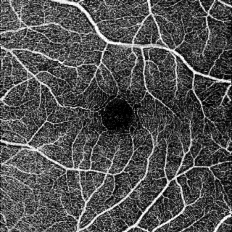
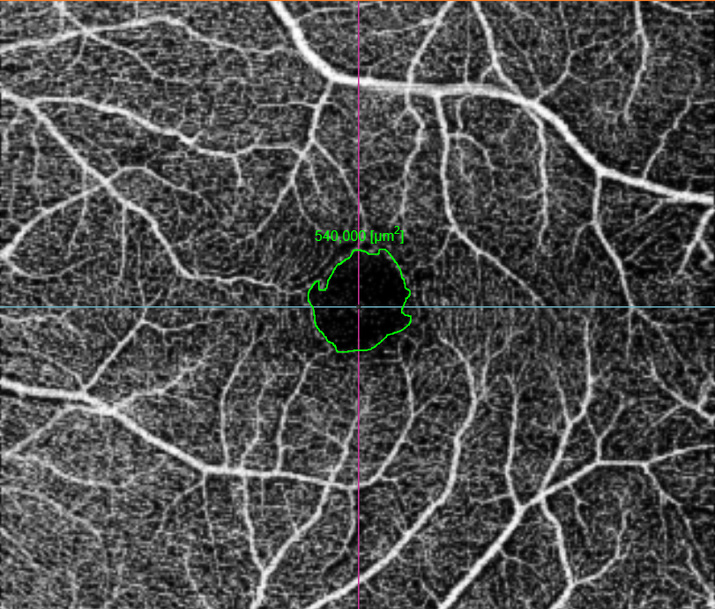
Retinal Avascular Foveal Zone as an Systemic Biomarker to evaluate Inflammatory Bowel Disease control
Luis Filipe Nakayama; Vinicius Campos Bergamo; Marina Lourenço de Conti; Nilva Simeren Bueno de Moraes; Lívia de Almeida Costa; Orlando Ambrogini Jr
INTRODUCTION
FIGURES
Inflammatory bowel disease (IBD) is a systemic inflammatory disease classified as Crohn Disease (CD) or Ulcerative Colitis (UC), according to the portion of gastrointestinal tract commitment. It could present extra intestinal findings, such as fever, weight loss, arthralgia, mucocutaneous lesions, hepatic, renal and ophthalmological involvement.
Nowadays, clinical parameters and colonoscopy establish criteria to controlled or non-controlled disease, defining treatment.
Our study objective was to compare Foveal Avascular Zone (FAZ) in patients with inflammatory bowel disease diagnosis between in remission and active diseases.
Foveal Avascular Zone – superficial vascular retinal layer 6x6mm – Image6 area delimitation
MATERIAL AND METHODS
We blindly evaluated 72 patients with IBD trough complete ophthalmological exam and posterior segment exams. Color fundus retinography, OCT and OCT Angiography was performed with Topcon Triton (Topcon®, Tokyo, Japan). Macula and posterior pole were evaluated with binocular indirect ophthalmoscopy and Fundus Biomicroscopy. Avascular foveal zone was determined with manual delimitation of superficial retinal image at Angio OCT exam with image6.net software.
CONCLUSION
Avascular foveal zone evaluation presents as an ophthalmological parameters that can help to determine whether the patient is in remission or activity of IBD disease and even spare invasive exams in disease follow up.
RESULTS
Participants mean age was 42.26 years (18-68), 28 male patients (38.88%) and 44 female patients (61.11%).
37 with diagnosis of Crohn Disease (51,38%) and 35 patients with diagnosis of Ulcerative Colitis (48,61%).
We didn’t found statistically difference between avascular foveal zone comparison between CD and RCU groups (p 0.91 for right eye and p 0.76 for left eye), but statistically difference comparing FAZ between remission and active group, in right and left eye (p 0.01 in right eye and p 0.02 in left eye).
REFERENCES
Ananthakrishnan AN. Epidemiology and risk factors for IBD. Nat Rev Gastroenterol Hepatol 2015; 12: 205–217.
Greenstein AJ, Janowitz HD, Sachar DB. The extraintestinal complications of Crohn’s disease and ulcerative colitis. Medicine. 1976;55:401– 12.
Yilmaz S, Aydemir E, Madem A, et al. The prevalence of ocular involvement in patients with inflammatory bowel disease. Int J Colo- rectal Dis. 2007;22:1027–1030.
Ghanchi FD, Rembacken BJ. Inflammatory bowel disease and the eye. Surv Ophthalmol 2003;48:663–676.
Knox DL, Schachat AP, Mustonen E. Primary, secondary and coinci- dental ocular complications of Crohn’s disease. Ophthalmology. 1984; 91:163–173.
Rankin GB, David Watts H, Melnyk CS, et al. National cooperative Crohn’s disease study: extraintestinal manifestations and perianal com- plications. Gastroenterology. 1979;77:914–920.
Felekis T, Katsanos K, Kitsanou M et al. Spectrum and frequency of ophthalmologic manifestations in patients with inflammatory bowel disease: a prospective single-center study. In amm Bowel Dis. 2009;15(1):29-34.
NAKAYAMA Luis Filipe, BERGAMO Vinicius Campos, CONTI Marina Lourenço de, BUENO Lívia, MORAES Nilva Simeren Bueno de, AMBROGINI JR Orlando. FREQUENCY OF OPHTHALMOLOGICAL POSTERIOR SEGMENT FINDINGS IN PATIENTS WITH INFLAMMATORY BOWEL DISEASE. Arq. Gastroenterol. [Internet]. 2018 June [cited 2018 Sep 24] ; 55( 2 ): 188-191.
DISCUSSION
Our study is the first to evaluate foveal avascular zone parameter in patients with IBD through OCT angiography performed with Triton.
We didn’t found difference in FAZ size between inflammatory bowel diseases (CD and RCU) parameters in both eyes.
Patients with clinical and colonoscopy classification of active disease presented decreased avascular foveal zone comparing to patients with remission of disease.
Avascular foveal zone evaluation presents as an ophthalmological parameters that is obtained non-invasively and is increased in ischemic diseases such as diabetic retinopathy.
It can help to determine whether the patient is in remission or activity of IBD disease and even spare invasive exams indisease follow up.
ETHICS COMMITTEE APPROVAL NUMBER
CEP Unifesp: 1453/2016
FINANCIAL SUPPORT
None

