Slide 1
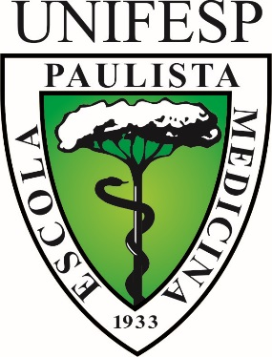
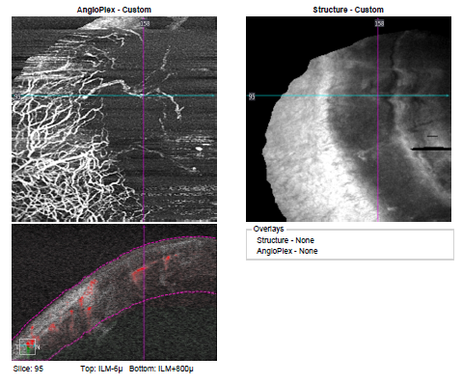
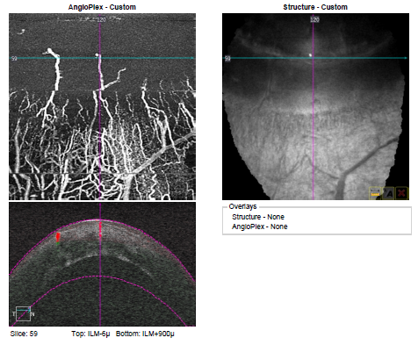
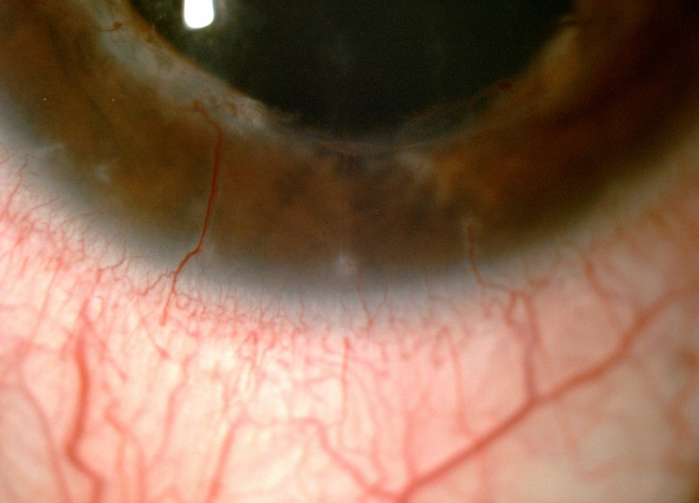
LIMBAL NEOVASCULARIZATION IN GRAFTED CORNEAS EVALUATED BY ANGIOPLEX ® OCT ANGIOGRAPHY
Elimar Mayara de Almeida Menegotto, Michelle de Lima Farah, Talita Cristine Mizushima,
Claudio Mauricio Zett Lobos, Ana Luisa Hofling-Lima
Introdution
The noninvasive image of anterior segment vascularization is still limited to the photograph of the slit lamp. Optical coherence tomography (OCTA) angiography has been widely used in the study of retinal and choroidal vessels, but corneal use is recent. To allow the capture of anterior segment angiography images, adaptations are necessary in the currently available equipment.
Purpose
To evaluate the Anterior Segment Optical Coherence Tomography Angiography to study limbal neovascularization in grafted corneas.
Methods
Case series including 17 eyes of 12 patients from the Escola Paulista de Medicina - UNIFESP and the Centro Oftalmológico São Paulo. The patients included had a history of corneal transplantation with limbic neovascularization detected by biomicroscopy and were submitted to examination by optical coherence tomography angiography (OCT-A) Images of the four quadrants (nasal, temporal, inferior and superior) of the eye under study were obtained by the Angioplex® system of
of the Cirrus HD-OCT 5000 device (Carl Zeiss, California, USA), with a specific power lens +10.00 adapted, specially developed to allow documentation of corneal neovascularization. The quality of the images in the different quadrants studied as well as the possibility of documentation of the depth of the vessels was analyzed.
Results
The use of the lens adapted to the CIRRUS equipment allowed the documentation of OCTA vascularization in all corneas studied in the four quadrants with good quality, including the normal vascular arcade and the vessels that penetrate the limbal area and the transplanted cornea. The examination also allowed to define the depth and the extension of the neovascular area with details.
Conclusion
Documentation of corneal neovascularization in patients with corneal penetrant keratoplasty with Cirrus Equipment adapted with the +10.00 lens was adequate to accurately delineate vessels without the need for contrast injection or contact.

