Slide 1
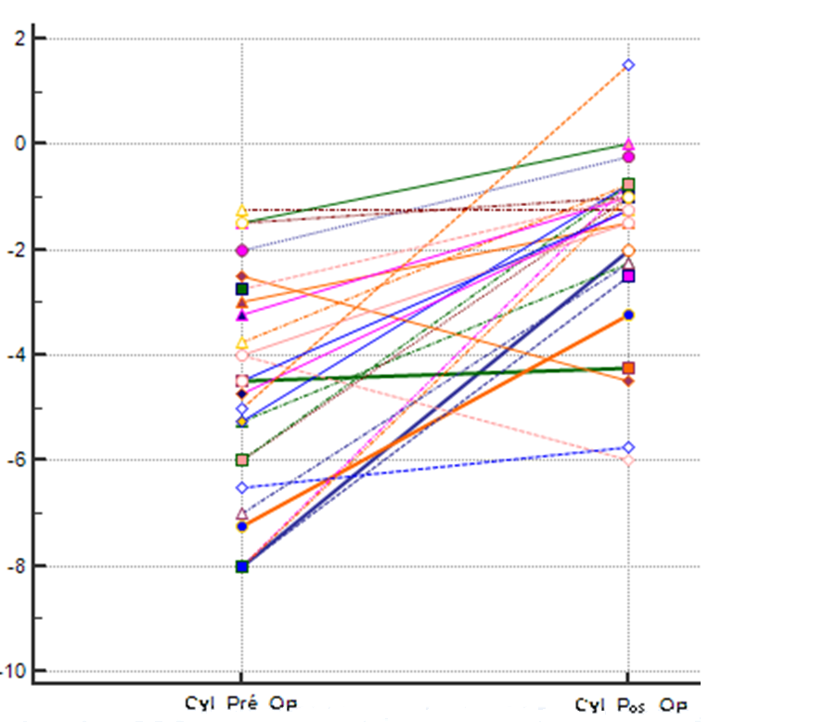
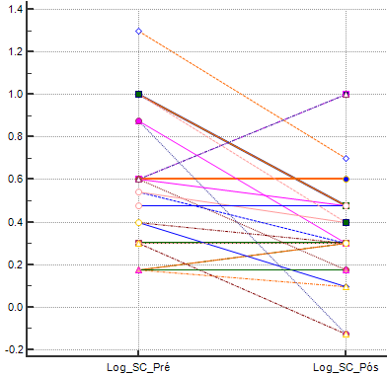
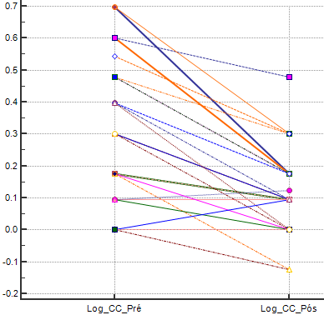
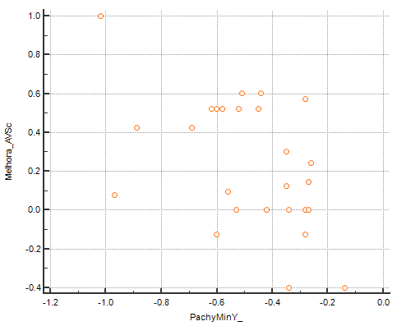
Tomographic and Biomechanical Corneal Analysis in Ring Segments Implantation for Keratoconus
Thiago Mazzeo, Bernardo lopes, Nelson Sena Jr, Renato Ambrósio Jr
INTRODUCTION
FIGURES, TABLES AND GRAPHICS
Keratoconus (KC) is a progressive non‑inflammatory condition, that results in conical protrusion of the cornea that can lead to myopia and irregular astigmatism. (1) The treatment of choice depends on the stage of the disease. In early stages, optical correction is well attained using spectacles and contact lenses. However, in advanced stages surgical treatments may be the only viables options.
Intracorneal ring segments (ICRSs) demonstrated to be a surgical alternative to at least postpone, if not entirely obviate, the need for lamellar or penetrating keratoplasty in KC. (2)
However, considering the results variability obtained from ICRS in KC, multivaried analysis could assist to create a possible correlation based on biomechical parameters, providing more precision and refractive previsibility for ICRS implantation, which is the goal of this study (3)
.
MATERIALS AND METHODS
Graphic 1
Graphic 2
This is an observational retrospective study, in which 26 eyes of 20 patients eyes with KC, were analyzed before and 6-months after ICRS implantation. All surgeries were realized with the same surgeon, under topical anesthesia and femtosecond laser-assisted placement of the ring segments. The pre and postoperative comparative analysis included: visual acuity with and without correction, refractional error, tomographic and biomechanical evaluation. The study was done using Pentacam HR and Corvis ST (Oculus Optikgeräte GmbH, Wetzlar, Germany) for tomographic and biomechanical assessment, respectively. MedCalc Statistical Software (version 16.8.4) was used for statystical analysis.
Graphic 3
Graphic 4
RESULTS
CONCLUSION
Considering all cases, there was a significant improvement of cylindrical refractive error (cyl) that can be seen on graphic 1 (median cyl value pre op was -4.625 and -1.250 pos op). Visual acuity with (CC) and without correction (SC), converted to logarithm of minimal angle resolution (LogMAR) was also significantly better after ICRS implantation. The median preoperative value of LogMAR SC was 0.602 and 0.349 CC, whereas, these values were 0.301 and 0.096 6-months after ring implantation (graphics 2 and 3). Graphic 4 shows a correlation between Improvement of visual acuity and pachimetry (IC 95% -0.693 to -0.0369)
ICRS are safe and useful for corneal modeling in keratoconus, however, biomechanical changes not yet fully understood, could be responsible for the limitation of the ring segments effect in some cases, leading to optical and refractive variability outcomes. (5)
Biomechanical parameters could assist to predict postoperative visual outcomes in a short and long term in these patients, however, more studies with bigger samples and multivaried analysis are necessary to elucidate this hypothesis.
DISCUSSION
REFERENCES
Other studies have also demonstrated steady and significant improvement of both uncorrected (UDVA) and corrected (CDVA) distance visual acuity after 6 months of follow up. An improvement in CDVA may be attributed to reduction in corneal aberrations. (4)
Even though the morphological effects of ICRS are well estabilished, optical and refractive unpredictable outcomes still occurs. This could be related to biomechanical aspects of the cornea, such as pachimety, as correlated in our study, that if better understood, could help granting a more precise result, both short and long term.
1 - Vazirani J, Basu S. Keratoconus: current perspectives. Clinical ophthalmology. 2013;7:2019-30.
2 - Ferrara G, Torquetti L, Ferrara P, Merayo-Lloves J. Intrastromal corneal ring segments: visual outcomes from a large case series. Clinical & experimental ophthalmology. 2012;40(5):433-9.
3 - Renato Ambrósio Jr, Costa-Ferreira C, Coelho V, Silva R S, Valbon B, et al. Intrastromal corneal ring segments for keratoconus: results and correlation with preoperative corneal biomechanics. Brazilian Journal of Ophthalmology. 2012;71 (2):89-99.
4 - Zare MA, Mehrjardi HZ, Afarideh M, Bahrmandy H, Mohammadi SF. Visual, Keratometric and Corneal Biomechanical Changes after Intacs SK Implantation for Moderate to Severe Keratoconus. Journal of ophthalmic & vision research. 2016;11(1):17-25.
5 - Pinero DP, Alio JL, Barraquer RI, Michael R. Corneal biomechanical changes after intracorneal ring segment implantation in keratoconus. Cornea. 2012;31(5):491-9.

